Slide 1
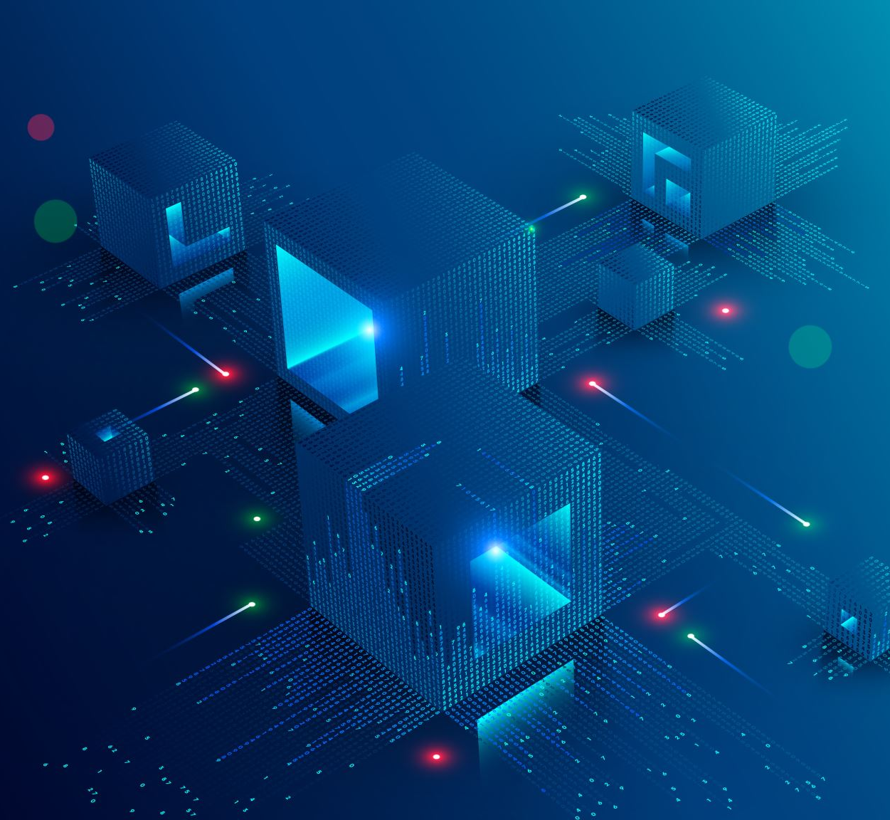
Session 9
Intro into 2D Physics
Particles
Aesprite
2D Lighting

